Slide 1




How is the Internet Affecting Our Intelligence
By: Prof (Dr.) Ashok Kumar Gupta
BE(MACT), M Tech (MANIT), PGDM (AIMA), DMS (NIM, New Delhi), LL B, Ph D (AISECT)
PROVOST-World Innovators University (WIU®),
Chief Managing Director-RFI
&
Satpuda Group of Institutions – Balaghat, M P, India
Date: 1st AUG 2024
Email: profdrashokkumargupta@gmail.com
Cell/WhatsApp: +91 94250 10901

Slide 2
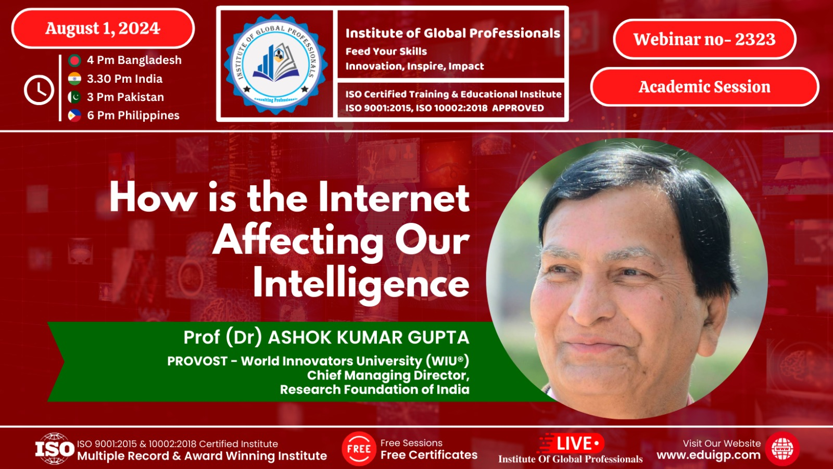

Slide 3
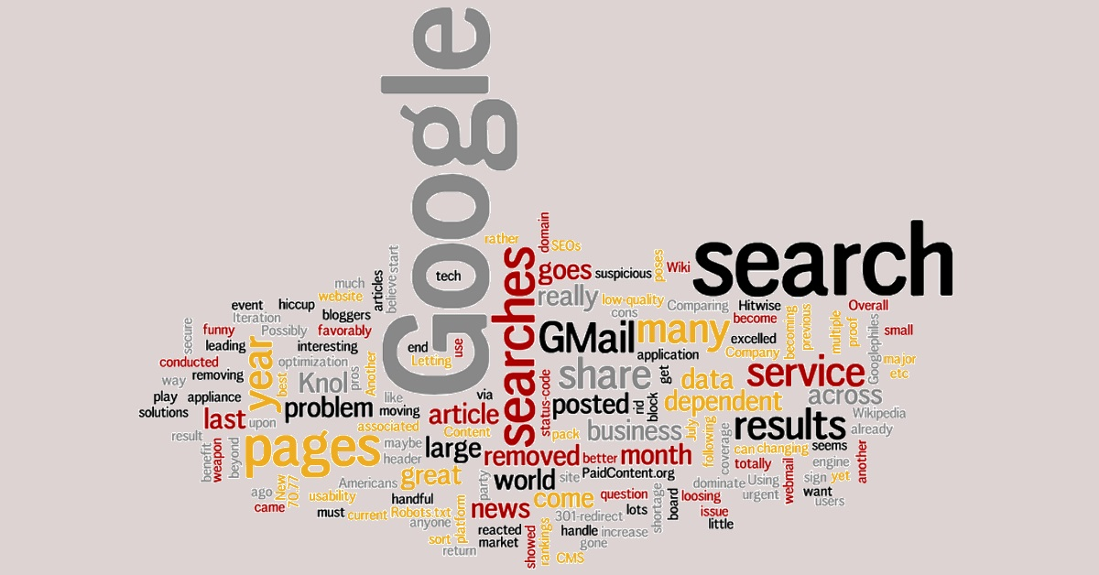
How does the Internet affect our Intelligence?
Since using the internet often involves our ability to multi-task between different settings—and somehow trains our brains to quickly shift focus to the stream of pop-ups, prompts, and notifications—this may, in fact, interfere with our ability to maintain focus on a particular cognitive task for extended times.

Slide 4
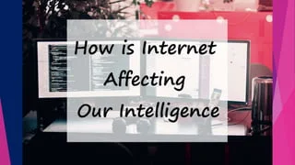
How does the Internet affect our Intelligence?
It may make us more easily distractible because it reduces our ability to ignore distractions.
In addition to its negative effects on cognition, excess internet use has been associated with a higher risk for depression and anxiety, and can make us feel isolated and/or overwhelmed.

Slide 5
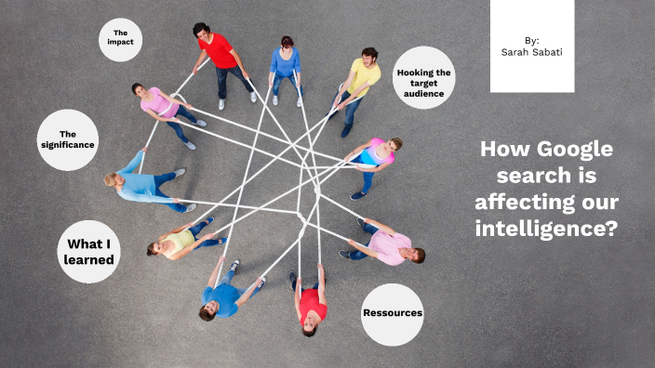
How does the Internet affect our Intelligence?
Despite many benefits, proven trends and facts indicate that our customary reliance on the internet every day is diminishing our originality, intelligence and high order thinking.
Internet, with its altering stimulation and constant distraction is changing the way we think – and not for the good.

Slide 6
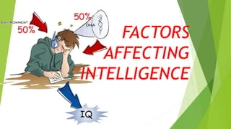
How does the Internet affect our Intelligence?
Our brains become accustomed to quick, shallow processing.
With information readily available through search engines, we may rely less on memorization, potentially affecting our ability to retain and recall information.

Slide 7
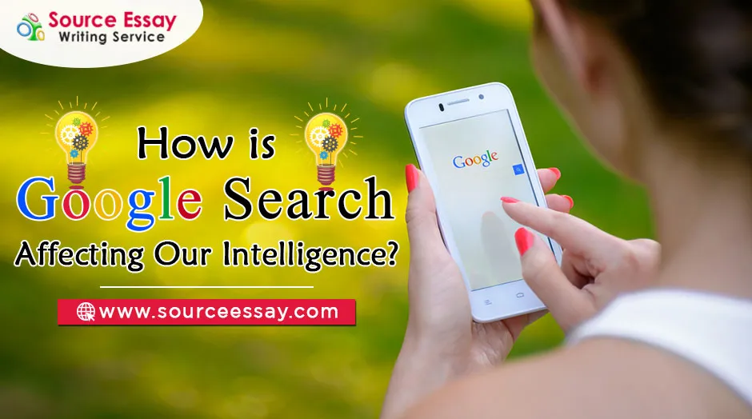
How does Google affect our intelligence?
What is the Google Effect?
The Google effect, also known as digital amnesia, is the tendency to forget information that is readily available through search engines like Google.
We do not commit this information to our memory because we know that this information is easy to access online.

Slide 8
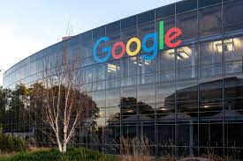
How does the internet affect intelligence?
Higher internet use has been associated with lower verbal abilities among young children.
Extensive internet use could also have indirect effects such as interfering with sleep or reducing academic or real-life social interactions.

Slide 9
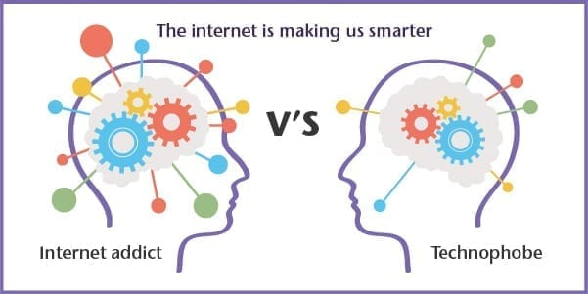
How does the internet affect us?
The Internet has changed business, education, government, healthcare, and even the ways in which we interact with our loved ones—it has become one of the key drivers of social evolution.
The changes in social communication are of particular significance.

Slide 10
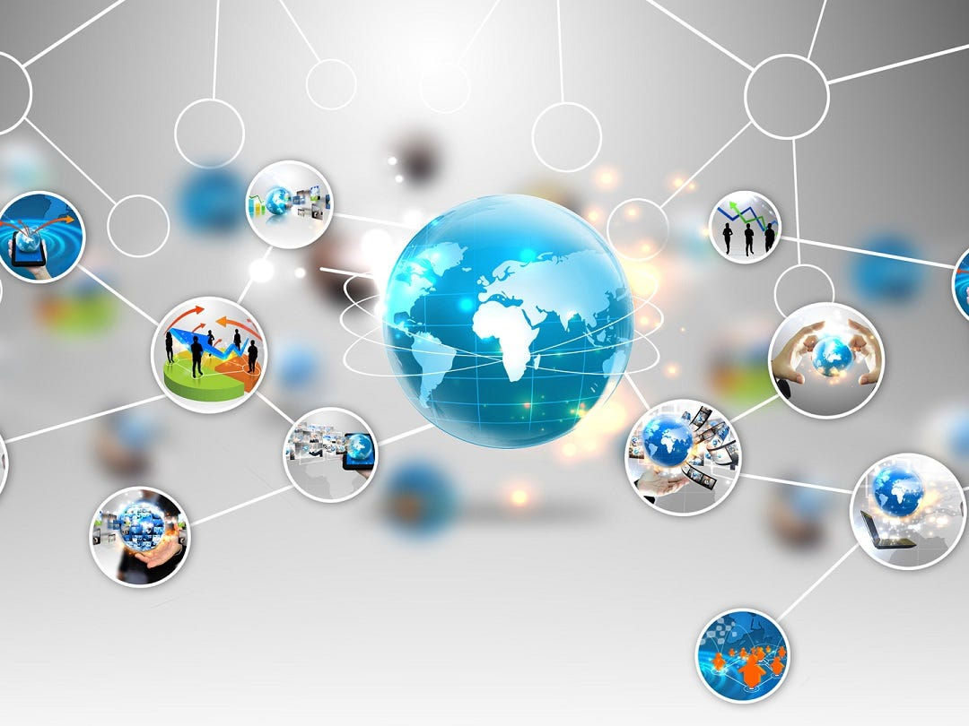
How does technology affect our knowledge?
Technology as a tool.
If we start from the premise that technology is created to solve problems / meet needs then, quite obviously, technology helps in the pursuit of knowledge by giving us new ways to acquire knowledge, reveals new knowledge to us, and allows us to synthesis pre-existing knowledge into new knowledge.

Slide 11
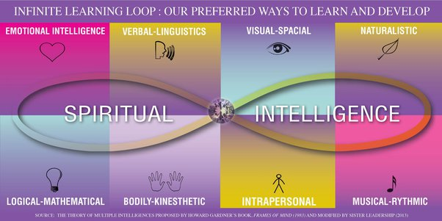
How does the internet help us?
It powers education and economy.
It supports our health and well-being.
And it connects us to our neighbors and to those we love. Without Internet we miss out on many of these benefits.

Slide 12
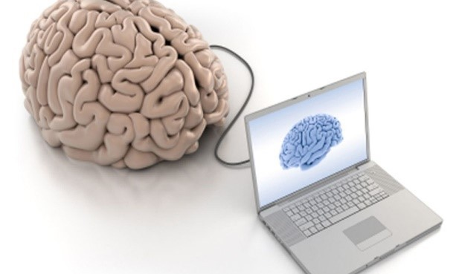
Is the Internet making us smarter?
"Three out of four experts said our use of the Internet enhances and augments human intelligence, and two-thirds said use of the Internet has improved reading, writing and the rendering of knowledge," said study co-author Janna Anderson, director of the Imagining the Internet Center.

Slide 13
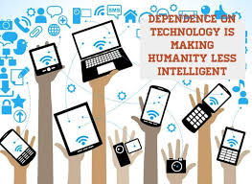
Do you think that the Internet is making people less intelligent?
The Google search engine is acting as an external memory.
Some neuroscientists argue that the internet, social media and the like is rewiring our brains, and not in a good way!
The truth is that at the moment we don't know whether the internet is having a deleterious effect on our intelligence.

Slide 14
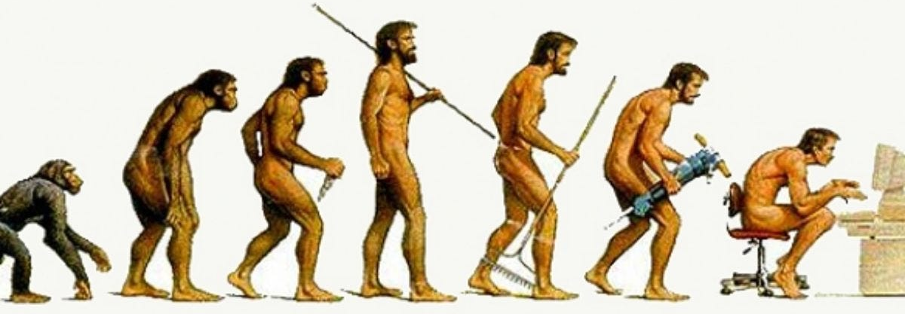
How is the internet affecting our intelligence?
YES! Both positive and negative effects are occurring.
Just as the written word negatively affected our intelligence when it was introduced, so does the internet affect our thinking.
After the written word flourished, after the Gutenberg press, our intelligence was exposed to both positive and negative intelligence effects.
Then, resolution expanded and audio information flourished, and world could listen to a “Fireside Chat”, all at the same time “together”, all over the globe.

Slide 15

How is the internet affecting our intelligence?
Television soon followed thereafter, and audio was joined with video motion images, first in black and white, followed by color. Since that point the resolution expanded and television received the review it deserved.
With the most recent stage of RESOLUTION increase, the internet, where all media is combined with interaction, our intelligence has dwindled for all the obvious reasons. Intelligence that does not have the ability to identify it’s own programming/biases, is in fact, not intelligence in the first place.

Slide 16
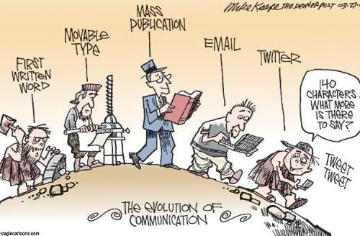
How is the internet affecting our intelligence?
What is your best grade in the classes called; Thinking, Thought, or How to Think?
Intelligent people prove themselves as such, by not reaching for their “Refute” button to prevent themselves from thinking, as such they think things through.
Programmed people never let their “Refute” button out of their reach. Then Never Know, when they are going to need it.

Slide 17
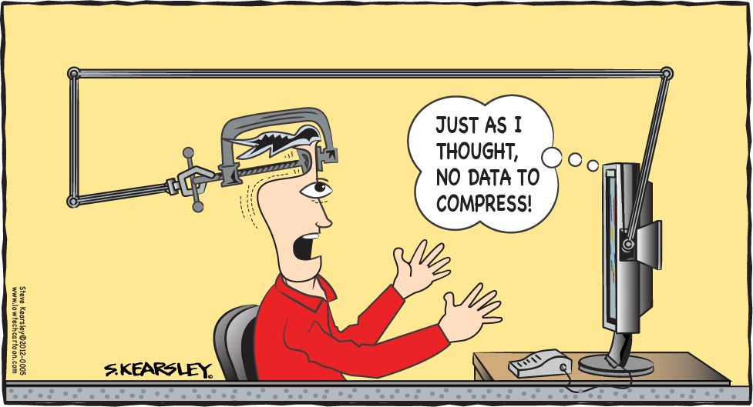
Why does the internet not make people smarter?
The internet is a tool. You can use it well. You can use it badly. Or you can chose not to use it at all.
You may not be able to raise your IQ with the internet, or any other tool. But you can certainly become better informed. You can learn new skills. You can fct check things that you hear.
Or you can use the internet to find confirmation for things you already believe. You can use the internet to find more extreme versions of what you believe

Slide 18

Why does the internet not make people smarter?
Most people don’t use the internet very well because their education didn’t teach them how to learn.
Some learned specific things, but not how to guide their own learning.
What they were taught was pretty well checked. It might have been incomplete but it wasn’t complete nonsense.
In older days learning how to keep on learning was a graduate school topic.

Slide 19
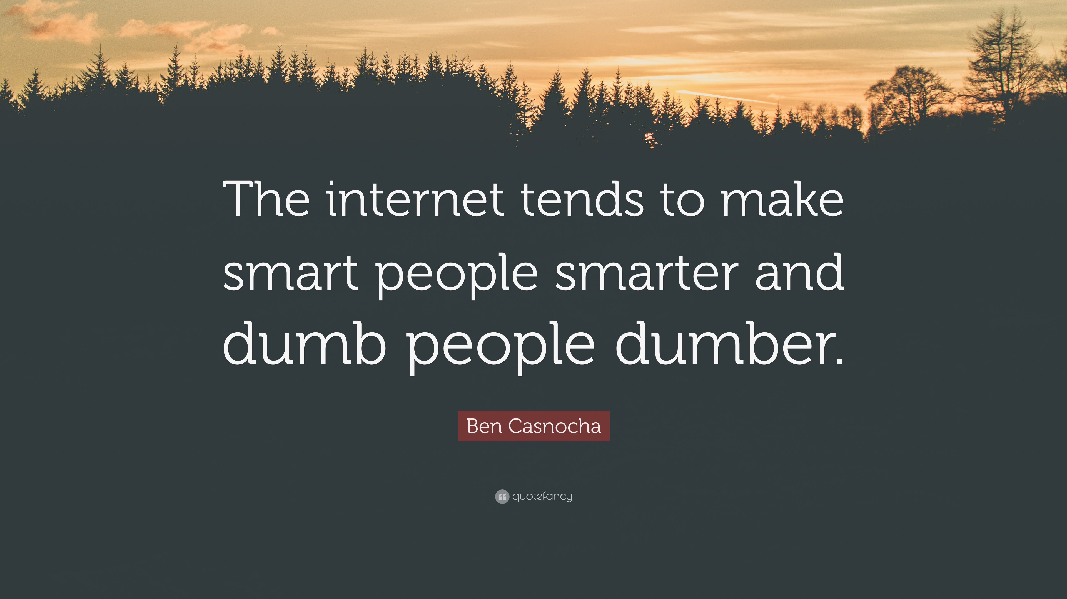
How do you think the internet affects our ability to critically consume information?
On the internet you can see actual videos, either short snippets or full uncut footage.
You can research your favorite topics. You can see and read content from opposing sides within seconds.
You are literally one minute away from learning how to recognize the age-old and the newest attempts at psychological manipulation. You can see patterns and learn quickly to recognize them.

Slide 20

How do you think the internet affects our ability to critically consume information?
You can access a piece of literature such as The Grand Chessboard in seconds, that explains decades of global politics and wars.
You can access incredible works of art such as Berserk, and ponder the depths of human spirit through a compelling dark epic allegory.

Slide 21

How do you think the internet affects our ability to critically consume information?
You can find a piece of literature, like a holy book verse, song lyrics or historical quote in seconds, track it to the source, get the date, location and context, have it translated and explained and send it to friends.
And once you see honest news, you can smell fishy crap from a mile away, even your intuition gets stronger.

Slide 22

How does the internet affect our minds?
It fills you with good and bad thoughts. you become addicted to it. if there is no internet, you feel life has come to a halt. you become like a machine. your emotions are not real but virtual. you lose the personal touch. you stop giving attention to your near and dear ones. you become aloof.
The other side is also interesting. you become more aware, you gain knowledge, you become innovative,
Choose how you want to live. with or without..

Slide 23

Has the Internet made people more intelligent?
There are many aspects to the definition of “intelligence” - by some of these the answer would be a qualified “yes”, and by most others, “no”.
The Internet has made it feasible for billions of people to publish vast amounts of information, with tools (e.g., search engines, blogs, topical websites, tutorial sites, etc.) that make it incredibly easy for people to be exposed to and/or seek out information of interest to them on pretty much any topic.

Slide 24
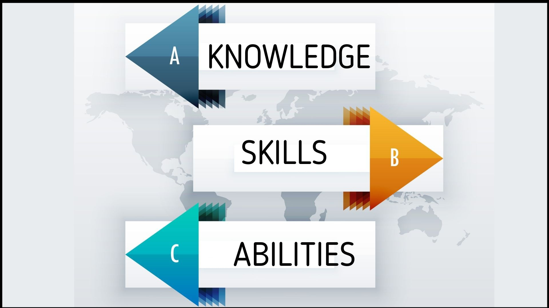
Has the Internet made people more intelligent?
One short-hand definition of intelligence describes it as, “the ability to acquire and apply knowledge and skills.”
The Internet certainly supports the first part of this.
The application of the knowledge and skills, however, is up to the individual, and includes various considerations such as innate cognitive skills, memory, abstract thinking, practice (cognitive skills can be improved, at least to some extent, by exercising them), discipline, emotional state, motivation and focus.

Slide 25
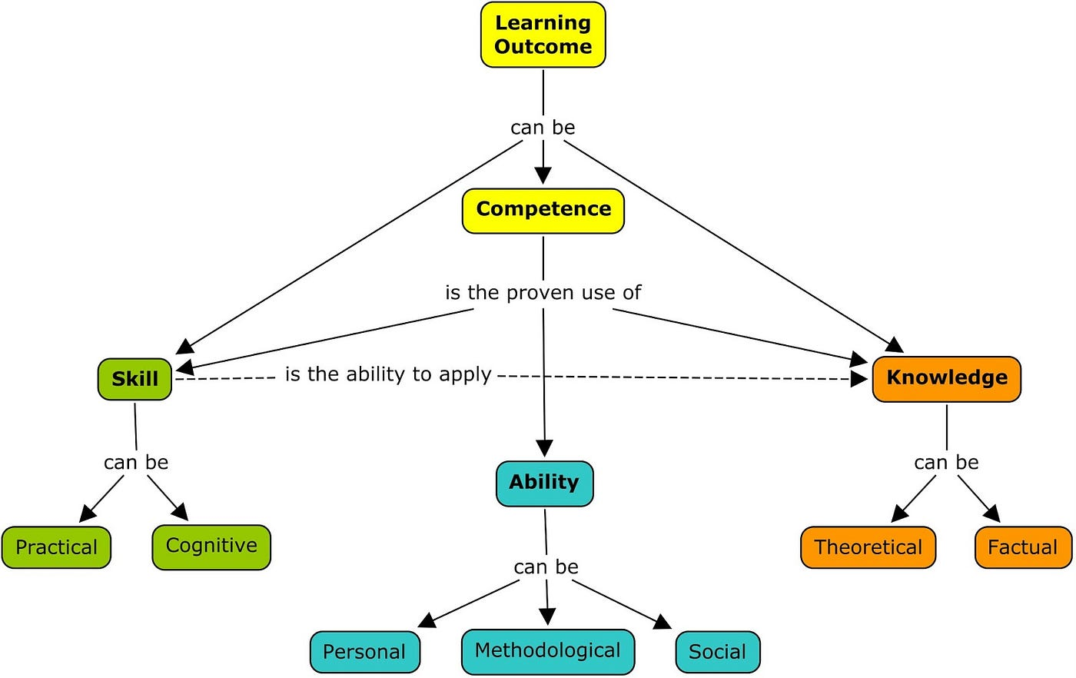
Has the Internet made people more intelligent?
The Internet makes it easier to learn or understand new or trying situations.
Regarding skilled use of reason, ability to apply knowledge, think abstractly - we might only credit some of this to the Internet for people who use it to learn and practice these skills.
In this sense, there’s nothing magical about the Internet - it’s just a vast and highly accessible information resource.

Slide 26
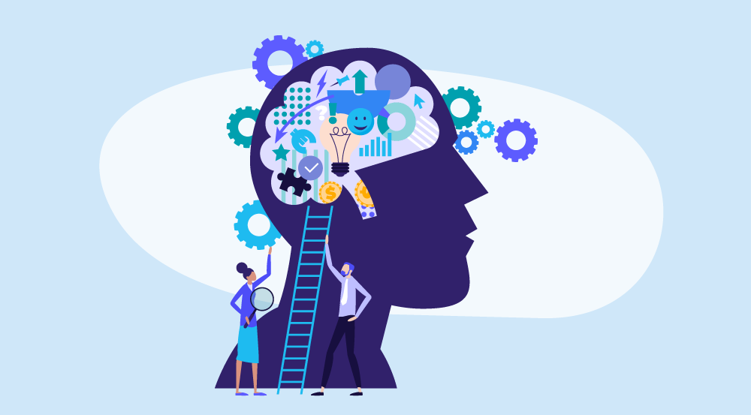
Has the Internet made people more intelligent?
To the extent that access to knowledge can facilitate the exercise and development of cognitive skills, the Internet might be said to be an aid in helping people achieve their potential for intelligence.
There are also cognition related skills such as hand-eye coordination that improve when people spend hundreds of hours in front of a monitor while using a keyboard.
But aside from these, the Internet isn’t really making people more intelligent.

Slide 27

Has the Internet made people more intelligent?
A lot of what you’re observing is also largely due to the fact that you’re now being exposed to a larger number of the intelligent people around the world that you would otherwise never have been aware of.
These folks may make better or more frequent use of Internet tools, thus becoming more visible and apparent to you than those who are innately less intelligent and make less use of the same tools.
Skewing the appearance of “average” intelligence that you see online.

Slide 28
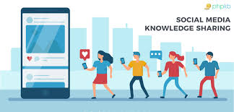
Has the internet made people smarter both intellectually and socially?
It’s made us more social and knowledgeable, but it has not made us smarter.
In fact it’s made us unable to think because we don’t know how to filter truth from crap.
There’s so much freaking information that people don’t have a filter and just consume assuming that information is correct.

Slide 29
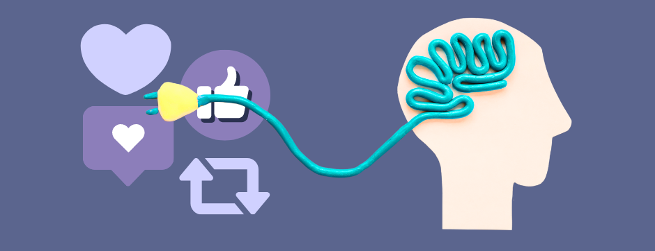
How is the internet affecting your intelligence?
How the Internet or well known as “Google Search” affecting our brain.
The internet is the most widespread and adopted technology in the history of humanity.
However, the impact of this new technology is at its peak of development and betterment of the people and society a decade ago, but now at present these technologies somehow damaging the human brains the influence that internet may have on our brain structure and its functioning also.
It also slowdown the thinking and imagination power of a person.

Slide 30
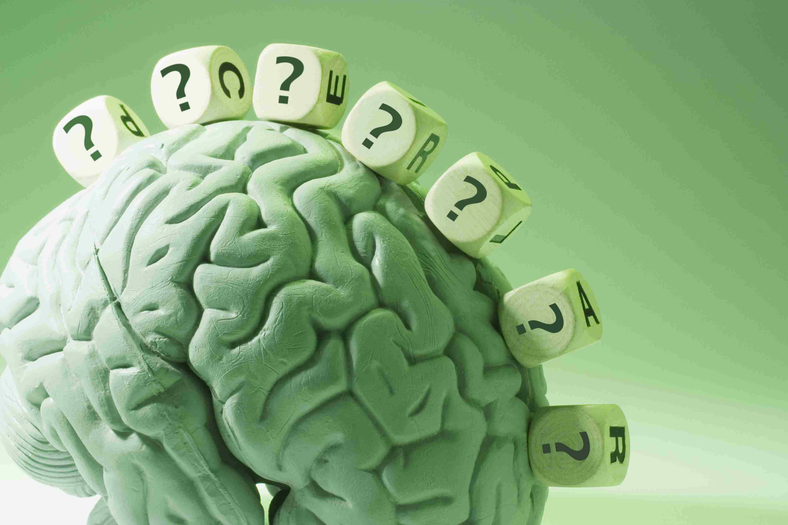
The internet does more harm than good?
There is no better resource than one that is completely free from any sort of legal restraint. If you ask the internet a question, it will definitely give you an answer. Its up to your brain to decide which answer is the best (or which answer suits your situation).
Society does that on a daily basis anyways. Why not use the tools that are available to you, to discover the very things that you wonder about!

Slide 31

The internet does more harm than good?
It’s as simple as this: Don’t allow harm, then harm wont be allowed.
But be aware! because there’s lots of muddy puddles that’ll drown you in a second! Its YOUR choice, nobody else’s.
And if you ever feel like you have lost control over your browsing situation, there is a little tiny red X in the right hand corner of your screen that will make it OK.

Slide 32
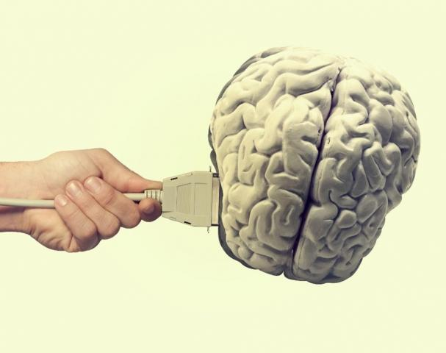
Is the internet frying our brains?
That's why experts advise people to avoid screens before bed. Every time we flick from one thing to another (as most of us do online), our brain adjusts.
This can be tiring over an extended period and explains why you feel shattered after an hour on the couch scrolling.

Slide 33
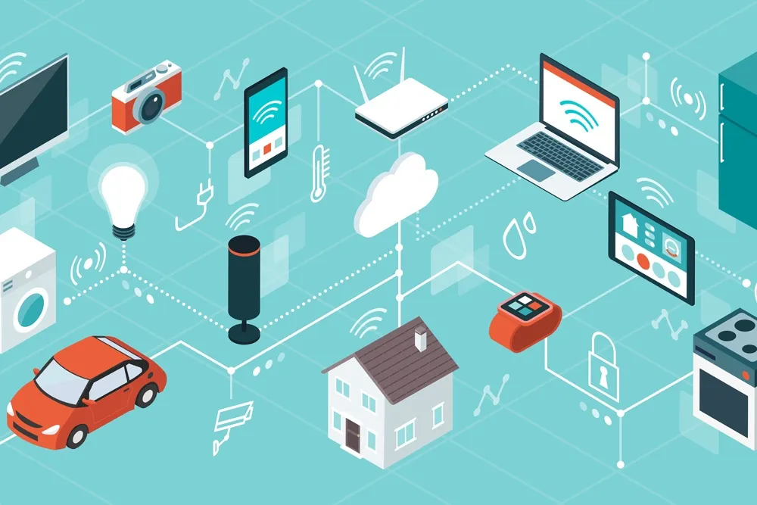
The impact of the Internet on knowledge
The Internet has effectively eliminated distance as impediment to the dissemination of knowledge. If knowledge exists in a digital form and has been published, then anyone can access it from anywhere, at anytime.
Needless to say, this is revolutionary. No longer is necessary to travel partway around the world to get research information. No longer do have to demonstrate that you're a credentialed researcher. No longer do you have to work within the constraints of the hours of some exclusive library.

Slide 34
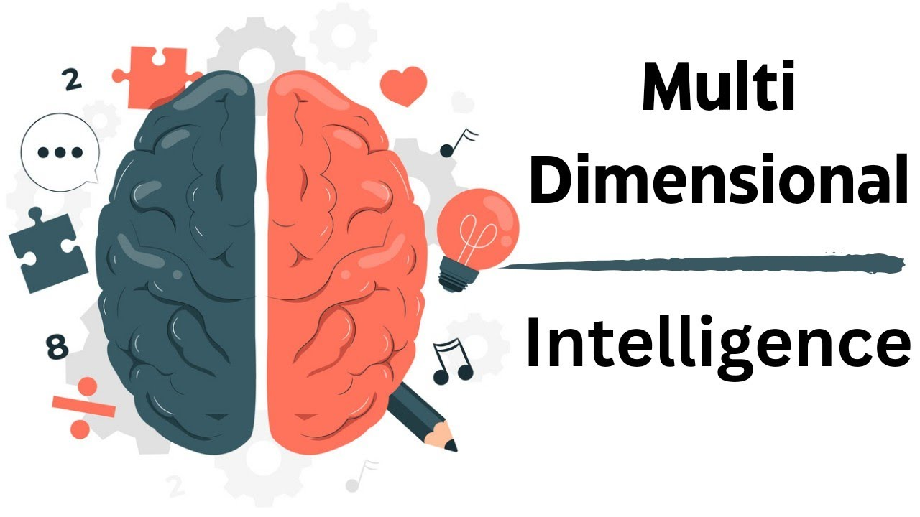
Effect of the internet on intelligence
Intelligence has multiple dimensions - Refer to Howard Gardiner’s multiple intelligence theory.
Internet has increased accessibility to knowledge by addressing all channel of sense making - visual, auditory, reading / writing. Information flow has increased exponentially.

Slide 35
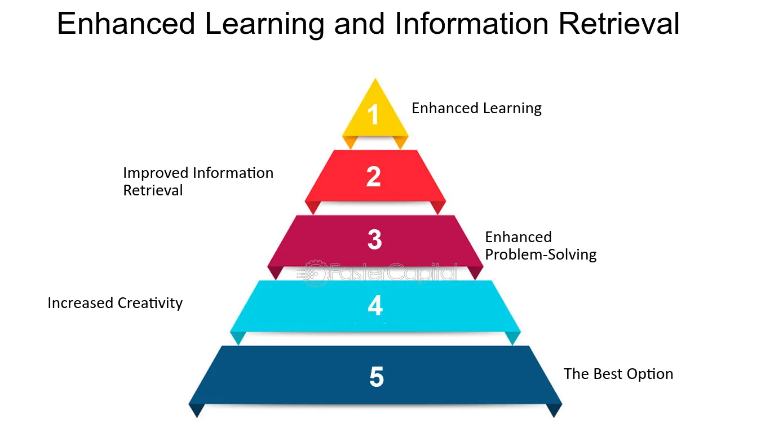
Effect of the internet on intelligence
The question is how much can one retain, recall ,retrieve and apply in related situations and unrelated situations. Overall, people are struggling at the recall and retrieval level. In our evolutionary times, with technology , our intelligence has increased substantially. With more advancement, the increase will be even more substantial as has been proven time and again.
So , the answer is internet has increased the intelligence of millions of people.

Slide 36
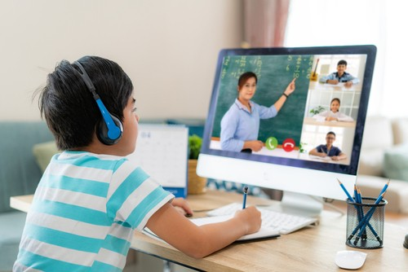
Negative effects of the internet on students
The Internet makes you dumb.
The expectation of fast, easy answers discourages serious research.
The convergence of many sites repeating the same (sometimes wrong) information crowds out critical thought.
The expectation of engaging, compacted, gamified content keeps information not meeting those criteria hidden from view.

Slide 37

Negative effects of the internet on students
Understanding how to do research beyond Google searching and Wikipedia is not well taught. Sources not freely or conveniently available at not sought out, either out of ignorance or laziness.
When presented with the need to doing serious, focused work, the attraction of the bite sized nuggets of goodness from the Internet is too distracting. The temptation to cut and paste is overwhelming.
The Internet is a fantastic tool for students, but one that requires serious training to use effectively as part of a complete curriculum.

Slide 38

Effects of the Internet on people's mental, psychological, physical, and social lives
The internet was not created to be such an energy-sucking platform that it has become. It drains you in every way, psychologically, physically and socially.
Psychological disadvantages
Excessive Internet use may create a heightened level of psychological arousal, resulting in little sleep, failure to eat for long periods, and limited physical activity, possibly leading to the user experiencing physical and mental health problems such as depression, OCD, low family relationships and anxiety.

Slide 39
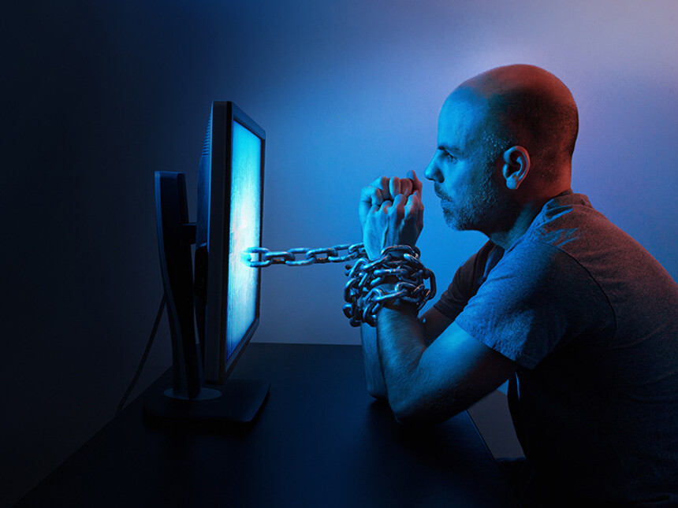
Effects of the Internet on people's mental, psychological, physical, and social lives
Physical disadvantages
First and most important, it affects your posture. Leading you to slouch, giving you a hump-back.
The blue-light from your phone could potentially lead you lack of sleep, or even insomnia. It also weakens your eyesight. Lastly, lying down using your phone for long periods, leads to laziness.

Slide 40
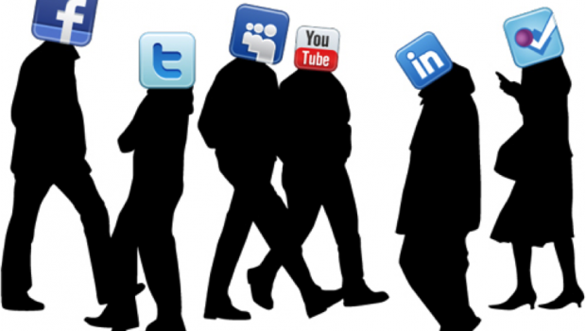
Effects of the Internet on people's mental, psychological, physical, and social lives
Social
The internet has affected the way we form and maintain relationships with friends, family, romantic partners, and acquaintances. Now that we can interact with each other and keep each other updated on our lives more easily than in the past, the notion of intimate relationships has changed, people find it weird talking face to face, and have lost all confidence in themselves.
As there are small-scale advantages, there are also large-scale disadvantages. Using the internet for limited purposes is beneficial, but using it excessively can only lead to disadvantage.

Slide 41

Do intelligent people use more internet?
As such there is no established correlation between a person’s iq level and the amount of time he spends surfing the net.
But it is well known and observed that people having higher mental acquity are much more interested in activities involving knowledge storing and sharing.

Slide 42
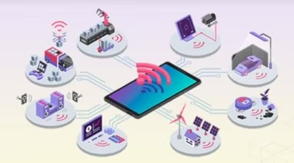
Do intelligent people use more internet?
This is because of the fact that a highly developed brain craves raw factual matter just like a typical greedy person has got an enormous appetite for food.
This phenomenon often creeps into online domain as well where users are forever searching for vast amounts of information in order to quench their thirst for awareness and mastery about the world around them.

Slide 43
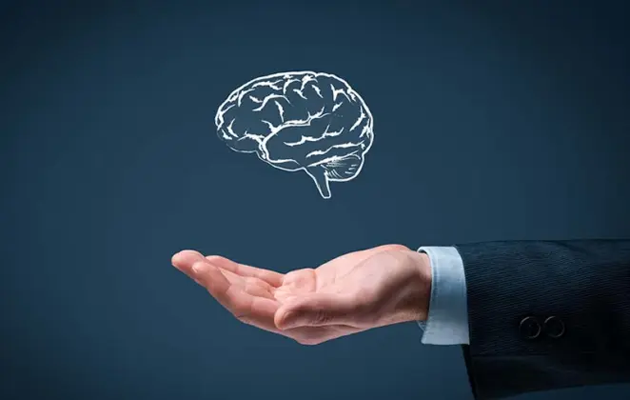
Do intelligent people use more internet?
So yes smarter people on an average use more resources at their disposal in the pursuit of increased know how and skills required to maximise their analytical and holistic understanding.
The bottom line is that in general people who are much more accustomed to racking their brains on a regular basis find a comfort place in the virtual world of unlimited and endless collection of data to be consumed by ever hungry souls in never ending and desperate quest for discovery of this universe.

Slide 44
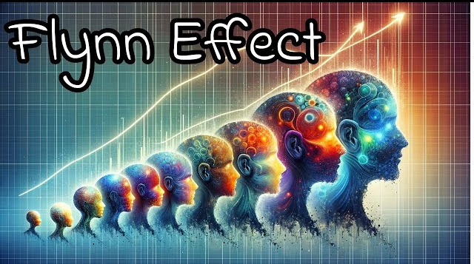
Is it there a vast amount of information on the internet or is our school/college education, making us smarter?
The Flynn Effect is the observation that people score better on IQ tests over time, such that they have to keep renormalizing the tests to maintain the population average at 100.
It has been around since long before the Internet; it's been measurable since IQ tests started being widely administered in the early 20th century.

Slide 45
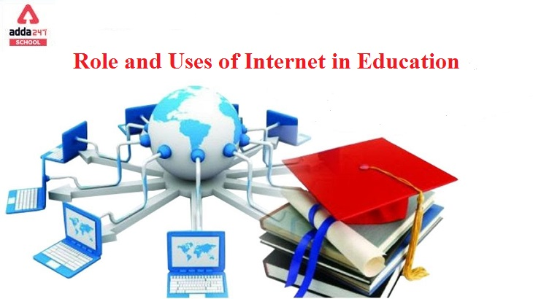
Is it there a vast amount of information on the internet or is our school/college education, making us smarter?
Proposed explanations for this effect include improvements in schooling, but also a more stimulating world--your Internet theory might fit in with this--as well as better nutrition and lower prevalence of infectious diseases (it's hard to learn if you're hungry or sick).
There's no consensus. I doubt it is any one isolated factor, just on the basis that society is complicated and brains are also complicated.

Slide 46
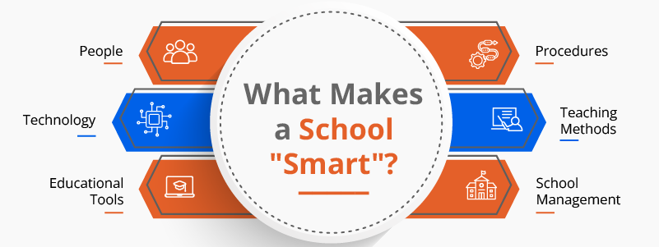
Is it there a vast amount of information on the internet or is our school/college education, making us smarter?
For students of all ages, there is a great amount of information available online outside of textbooks.
To fill the gap between students and resource limitations, a number of online learning systems have evolved.
If we look deeply, sometimes our teachers can help us more than the Internet.
We can just get the answer in the Internet but our teachers can explain us. Moreover, we would learn better if there is a face to face communication.

Slide 47
References:
https://www.google.com/search?q=How+is+the+Internet+Affecting+Our+Intelligence&oq=How+is+the+Internet+Affecting+Our+Intelligence&gs_lcrp=EgZjaHJvbWUyCQgAEEUYORiABDIHCAEQABiABDIICAIQABgWGB4yCAgDEAAYFhgeMgoIBBAAGIAEGKIEMgoIBRAAGIAEGKIE0gEIMTQyM2owajeoAgiwAgE&sourceid=chrome&ie=UTF-8
https://www.quora.com/Some-people-say-that-the-internet-affects-our-intelligence-To-what-extend-do-you-agree
https://www.google.com/search?sca_esv=5b7cee1fde2d1431&sxsrf=ADLYWIK_nJKXJzUDVC6Dvb-LftfQW3g38Q:1722150499190&q=How+does+the+Internet+affect+our+Intelligence%3F&udm=2&fbs=AEQNm0AeTedd363mDeLOoaMPCXujxSBkY78vUTqjwbAdGMY_Rxv7wolJr3dOUDYoSJqSihSGfFG7v67hpBTC8tsn8uRKr2UYGznZcQIQBMD-3SHOxYd2DVd_jkLQUa4wr_pRdurTqlGuKJpBDv_pGIP8bfi4_5n7F6MKn38ulpdJR7Qsu2rdqDDypTdUqtkmxjKYuhuPoAHi9kg1wNfMTLtx5OeGkCnhbHwOXWAzhj8JJVhIH15q-qAojpaADmLvNtmHLY5LXB_r&sa=X&ved=2ahUKEwj86oPGlsmHAxVMwzgGHZi_CbgQtKgLegQIDhAB&biw=1366&bih=641&dpr=1
chrome-extension://efaidnbmnnnibpcajpcglclefindmkaj/https://www.irejournals.com/formatedpaper/1702209.pdf

Slide 48


Any Question Please ??
Or
You may contact through
Email: profdrashokkumargupta@gmail.com
Cell / WhatsApp: +91 94250 10901

Slide 49
Link

