Slide 1
Introduction to Research Writing/ Research idea conceptualization
Dr Akaninyene Mark
MBBcH(Cal), MPH(Uniport), FWACP, PhD in view
Consultant Public Health Physician

Slide 2
Outline
What is research
Types of research
The differences between project and research
Steps in conducting a research
Skills in research
Principles/ responsibilities of a good researcher
Developing research Ideas
Tips on format of Dissertations
conclusion

Slide 3
What is a Research?
Research – process through which we search for convincing explanations of the phenomena in the world around us
Research is the systematic and rigorous process of enquiry which aims to describe phenomena and to develop explanatory concepts and theories and ultimately aims to contribute to a scientific body of knowledge
A process of steps used to collect and analyze information to increase our understanding of a topic or issue. It is a dynamic process.
It is a systematic scientific method aiming at identifying and solving health problems.(World Bank, 2020)

Slide 4
It adds to the scientific knowledge and guide the provision of information needed as a base for planning and decision making , leading to improvement of the community health both locally and nationwide.
Scientific research plays a very important role in our efforts to maintain health and combact myraid of diseases
It helps to create new knowledge and develop proper tools for the use of existing knowledge in solving problems of humanity

Slide 5
Types of research
Researches can be classified based on several considerations such as:
Field of research e.g. scientific research, social research, medical research, environmental research etc
Quantitative, qualitative research and experimental research
Observational and descriptive research
Basic, applied and developmental research.

Slide 6
Scientific research
This research provides scientific information and theories for the explanation of the nature and the properties of the world.
It makes practical applications possible
The research should be of evidence-based best practices.
Quantitative Research
This is the collection of numerical data.
Features are classified and counted, and statistical models are constructed to analyze and explain the information that has been gathered.
Some of the tools used include questionnaires, drug information, equipment that is used to measure something and databases of existing information.

Slide 7
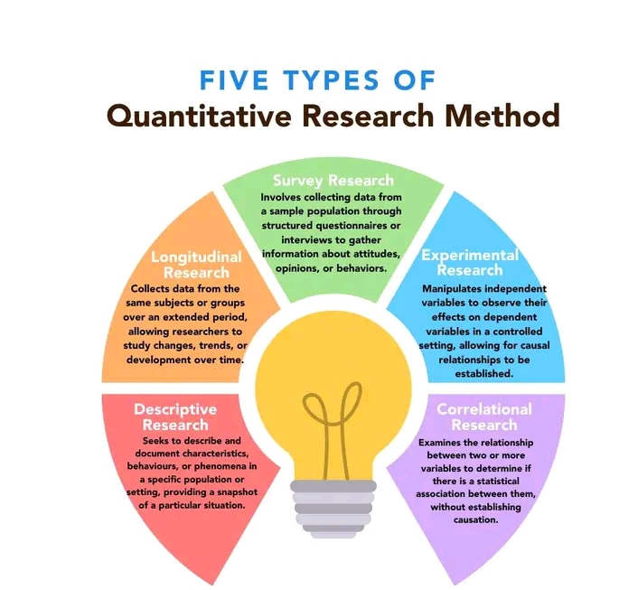

Slide 8
The goal is to compile statistical evidence, so the results are often summarized numerically, even the open-ended questions, though this is less often used for data collection in quantitative research.
Words like compare, relate, correlate are quantitative
Qualitative Research
Qualitative research is subjective and seeks to describe or interpret whatever is being researched.
Instead of numbers, this type of research provides information in the form of words, stories, narrations, or visual representations-videos.
It relies on the researcher to observe, record what happens, such as participants' answers to open-ended questions, subjects' behavior or the results of experiments.
Case studies, FGD are common examples of qualitative research.
The results are usually arranged along the thematic lines of the study.
Words like explore, understand, generate are qualitative in nature

Slide 9
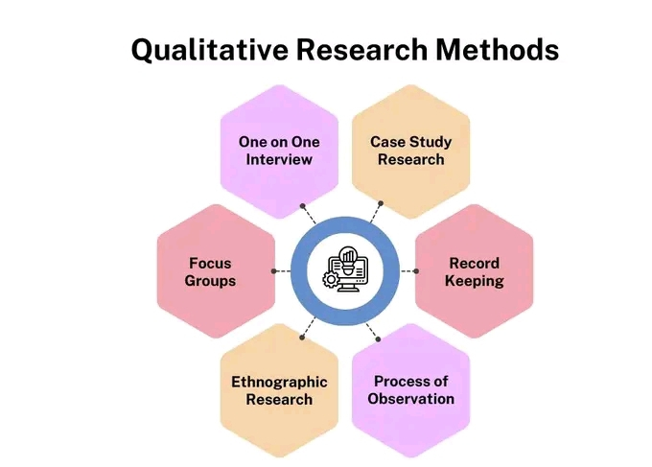

Slide 10
Descriptive Research
Descriptive studies are form of observational studies, no element of control. They study the frequency and distribution of disease or health-related events in human populations.
Experimental research
In Experimental research, the researcher sets the parameters or conditions and is able to change them to determine their effects. 2 forms are RCT and non-RCT

Slide 11
It can be conducted in clinics, laboratories, radiology or communities.
It requires the researcher to be able to control one or more conditions of the experiment.
This method helps researchers understand how certain variables affect what is being studied
Observational research
It is the examination of things as they naturally or inherently occur.
The researcher simply observes, describes, measures or records what occurs.
The information is then analyzed and used to draw conclusions.
Typical examples of observational researches are cohort studies, case- control studies, cross sectional descriptive studies, ecological studies, case series .

Slide 12
Classification of types of quantitative research
Any intervention?
Yes No
Experimental study
Random allocation?
Yes No
Randomized controlled trial
Non-randomized controlledtrial/Quasiexptalstudies
Observational study
Any controls?
Yes No
Analytical study
What’s the direction of investigation?
Descriptive study
From Exposure to outcome-
Cohort Study
From outcome to exposure-
Case-control study
-Case report/Case series
-Cross-sectional study
-Ecological study

Slide 13
Research different from a project
What is a Project? – “A human activity that achieves a clear objective against a timescale” (Source: The Association of Project Managers)
– “A non-repetitive activity that is goal oriented, has a set of constraints, has a measurable outcome and changes something” (Source: Maylor, 1996)
Naïve researchers often used the term project interchangeably with research.
Project is a specific and finite activity that gives a measurable and observable result under preset requirements. Research is a systematic investigation and study of materials, sources to establish facts and reach new conclusions

Slide 14
Research | Project
1.Research is a careful study conducted using a systematic approach and scientific methods. | 1.Project is a collaborative or individual enterprise that is carefully planned to achieve a particular aim.
2.Mainly carried out in academia, for the award of fellowships, masters etc | 2. Can be seen in a variety of contexts, including businesses
3. The main aim of research is to seek or revise facts, theories, or principles with the view to adding to scientific body of knowledge | 3. The main aim of a project is to achieve a tangible or intangible result; for example, product, service, competitive advantage etc

Slide 15
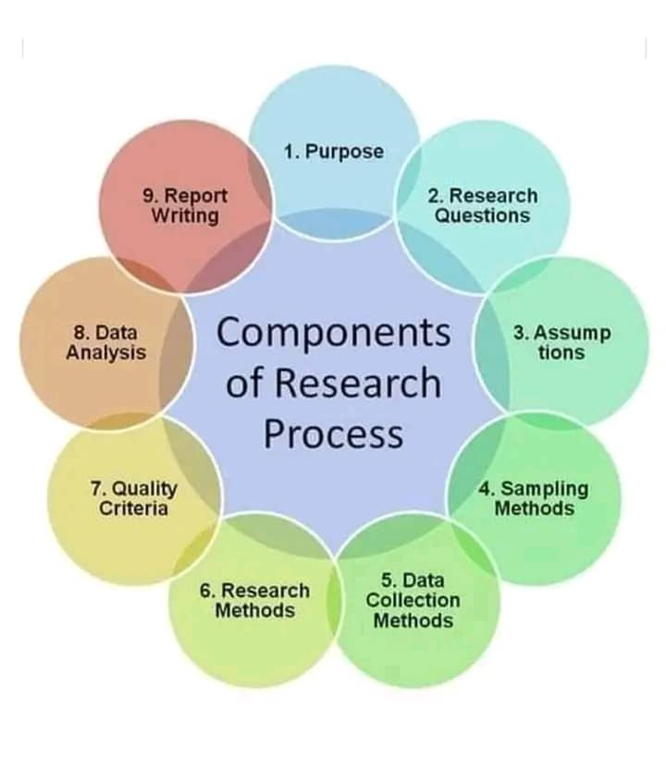
Components of Research process

Slide 16
STEPS IN CONDUCTING A RESEARCH
Planning a research==OSPSSCSDIE
Concept
Choose a topic
Establish research team
Allocate/assign roles
Develop a proposal/protocol
Implementing the research
Reporting/ Dissemination of the research findings

Slide 17
Tips on Planning your research
What’s your interest?
Select the right topic
Find the right supervisor
Develop a feasible plan and keep it simple and achievable
Prepare a project timeline and stick to it
Avoid distractions and focus on the set plan
Ask questions from senior colleagues
Do not plan to plagiarize someone’s work
Apply the principles/ responsibilities of a good researcher

Slide 18
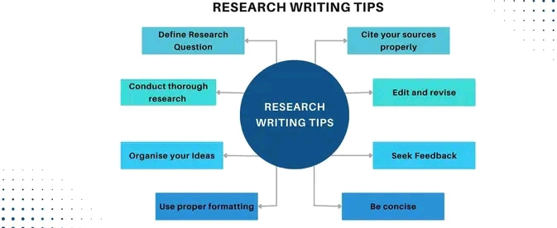

Slide 19
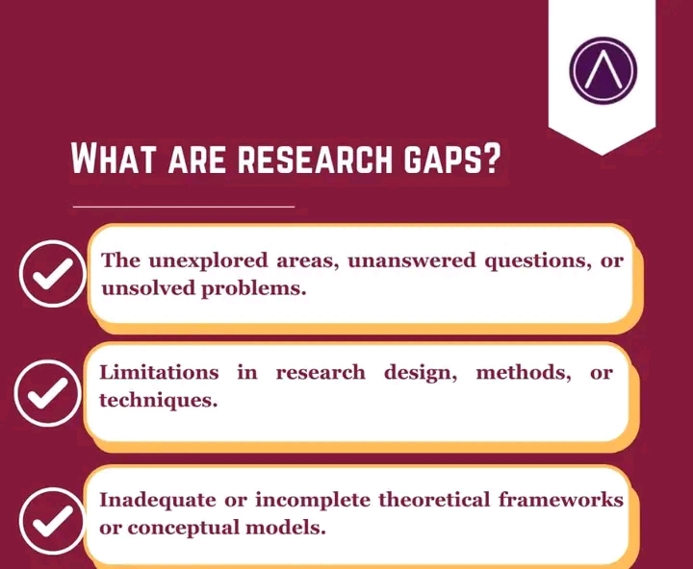
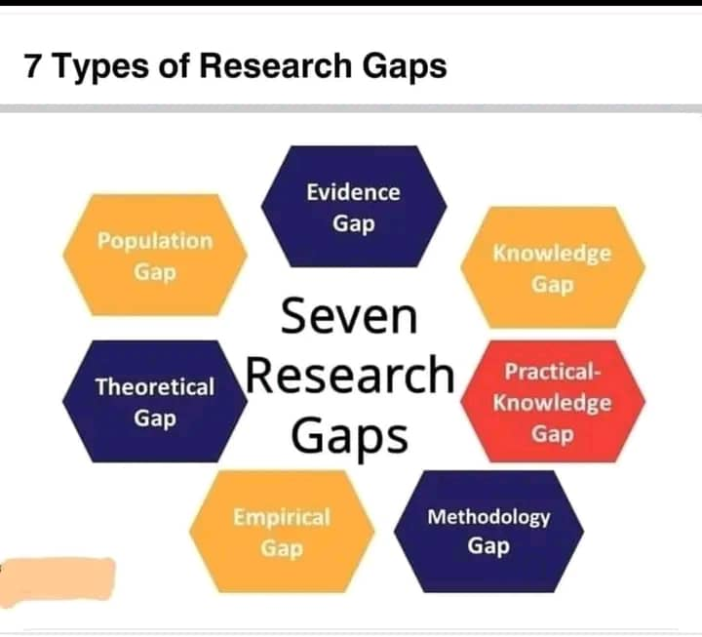

Slide 20
Sequence in research development
Choice of topic/ supervisor
Read literature
Finalize objectives
Concept development
Proposal development
Develop research instrument
Ethical approval
Pretesting/revise instrument
Field work
Data analysis
Results
Discussion, conclusion
Referencing
Submit to supervisor, assessor
Presentation and defense

Slide 21
Criteria for choosing research topic?
Technical
Feasibility
Interest
Financial
Resources
Novelty (newness)
Legal
Ethic
Relevance

Slide 22
FRIENDS FRAMEWORK FOR SELECTING RESEARCH TOPIC
FRIENDS
Manpower
Time frame
Financial
Capability
F₌ Feasible
R ₌Relevant
Scientific
Practical
Personal
I₌ Interesting
Motivation
Passion
Curiosity
E₌ Ethical
Human
Code of ethics
N₌ Narrow
Neither too broad
Neither too narrow
Focused/specific
D₌ Discipline
Core discipline
Related discipline
Standards
S₌ Supervisor
Knowledge
Interests
Commitments

Slide 23
Important Consideration in choosing Dissertation topic
Area of interest
Previous work/publication
Topical issues in the specialty
Literature search online
Recommendation from previous dissertation in the specialty
Availability of data and information
Ability to manage the process-feasibility
Characteristics of a good Dissertation topic
Controlled/ measured- keep control over the entire process of research
Accuracy, valid and generalized
Clarity, free from ambiquity
Logical writing
Coherence
Originality
Simplicity of language
Consistency with institution/college guidelines

Slide 24
Tips for success in research
Schedule planning time
Write a daily ‘to do list and estimate time per task
Set up effective systems for managing people and emails
Use your prime time
Do not procrastinate, start somewhere

Slide 25

To understand time, you need to analyze time usage: –Keep a daily time log
Complete time sheets
Make notes of what you do
when to do them
for how long is it going to be done

Slide 26
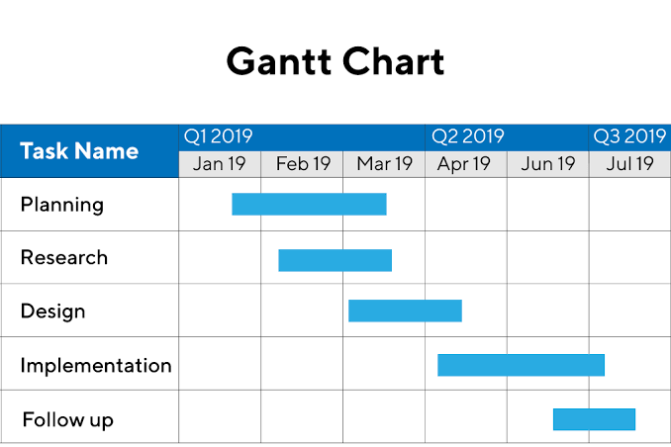
“Work Plan”
Involves listing against time, the tasks required to plan, execute, analyze, report, and disseminate the findings of the research.
Henry Gantt in the 1910s, illustrates a project schedule; the start and finish correspond to the length of each bar.

Slide 27
Principles governing good research
Honesty in all aspects of research
Accountability in the conduct of research
Professional courtesy and fairness in working with others
Good stewardship of research on behalf of others

Slide 28
Responsibilities of a researcher
1. Integrity: Researchers should take responsibility for the trustworthiness of their research.
2. Adherence to Regulations: Researchers should be aware of and adhere to regulations and policies related to research.
3. Research Methods: Researchers should employ appropriate research methods, base conclusions on critical analysis of the evidence and report findings and interpretations fully and objectively.
4. Research Records: Researchers should keep clear, accurate records of all research in ways that will allow verification and replication of their work by others

Slide 29
5. Research Findings: Researchers should share data and findings openly and promptly to team, as soon as they have had an opportunity to establish priority and ownership claims.
6. Authorship: Researchers should take responsibility for their contributions to all publications, funding applications, reports and other representations of their research. Lists of authors should include all those and only those who meet applicable authorship criteria.
7. Publication Acknowledgement: Researchers should acknowledge in publications the names and roles of those who made significant contributions to the research, including writers, funders, sponsors, and others, but do not meet authorship criteria.
8. Peer Review: Researchers should provide fair, prompt and rigorous evaluations and respect confidentiality when reviewing others' work.

Slide 30
9. Conflict of Interest: Researchers should disclose financial and other conflicts of interest that could compromise the trustworthiness of their work in research proposals, publications and public linkages.
10. Public Communication: Researchers should limit professional comments to their recognized expertise when engaged in public discussions about the application and importance of research findings and clearly distinguish professional comments from opinions based on personal views.
11. Reporting Irresponsible Research Practices: Researchers should report to the appropriate authorities any suspected research misconduct, including fabrication, falsification or plagiarism, and other irresponsible research practices that undermine the trustworthiness of research, such as carelessness, improperly listing authors, failing to report conflicting data, or the use of misleading analytical methods.

Slide 31
What makes a good research?
Purpose should be clearly defined
Methodology must be carefully designed in line with the purpose and to achieve maximum validity
Methodology must be documented to a level of details that enables another researcher to repeat it
Limitations should be spelled out to enable proper assessment of the strength of the evidence presented in the research
Conclusion should be justified and based on data and theory
Significance and implications should be clear
Research should be done in an ethical way

Slide 32
Developing research ideas
Research ideas can be generated through rational or creative thinking. While all the techniques of the rational thinking should be used, a subset of the creative ones can be used. Whatever is identified should be refined with further reading.(philip Lewis and Sauders, 2021)
RATIONAL THINKING | CREATIVE THINKING
Examining your own strengths and interests | Keeping a notebook of your ideas
Examining staff research interests | Exploring personal preferences
Discussion | Utilize the opportunity
Searching the literature | Brainstorming
Scanning the media | Apply Gantt chart
Looking at past project titles | Get it done

Slide 33
TIPS ON FORMAT OF DISSERTATION;
GENERAL
The conduct of a good research and presentation of a dissertation therefrom successfully defended during the exit exams are a prerequisite for certification by postgraduate colleges.This is an era of evidence based medical practice. Reliable evidence are generated from valid, well conducted research
Dissertation – Master’s Degree/ Fellowships
Thesis – Doctoral Degree
Font type for all Thesis/Dissertation is Times New Roman
Font size is 12.
Double spacing
Body of Thesis/Dissertation should be double line
Abstract should be single line spacing
Tables, titles, reference list should be single line space

Slide 34
PRELIMINARY PAGES
Cover pages
Title page
Declaration
Certification
Dedication
Acknowledgements (1 page & start with Supervisor)
Abstract (single line spacing, max 300 words)
Table of Contents
List of Tables
List of Figures
List of Abbreviations/Symbols (where applicable)

Slide 35
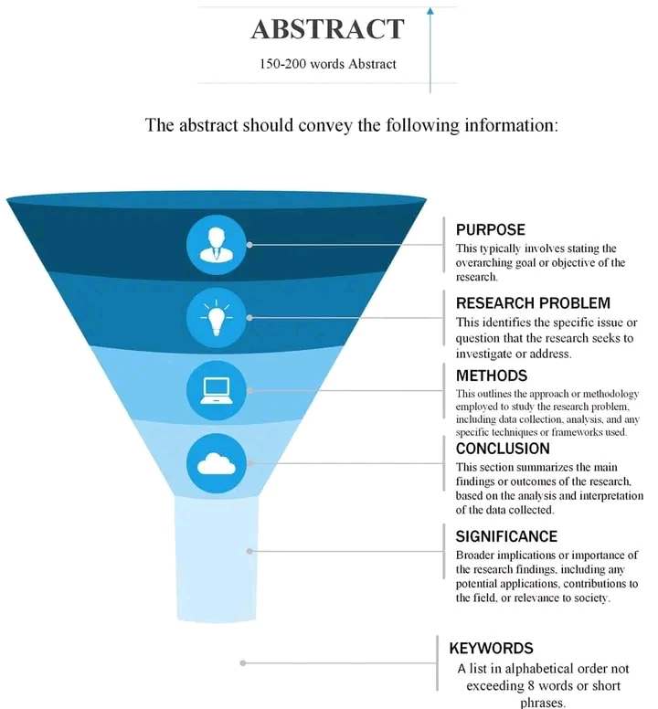
Abstract presents a concise summary of the entire dissertation, a must read part of the work, it must be interesting, captivating and contain essential information.
Introduction, Objectives-SMARTER, Methods, Results, Conclusion and Keywords.
Abstract

Slide 36
CHAPTER ONE: INTRODUCTION
Background to the Study: It offers a summary of the evidence/current knowledge about the topic, It explains the problem to be addressed, history and issues important to the problem
Statement of the Problem: It has to be stated in terms of WHAT, WHO, WHERE WHEN and WHY, population group affected, economic significance etc
Rationale/ justification for the study: It gives the scientific evidence for your study or explains why your study is very important, highlight gaps in the present study.
Aim and Objectives of the Study: SMART
Research Questions using FINER criteria-Feasible, Interesting, Novel, Ethical and Relevant
Hypotheses (if required) The Null and Alternate hypotheses

Slide 37
CHAPTER TWO: LITERATURE REVIEW-The heart of the research process. It’s a research on its own.
Theoretical/Conceptual Framework
Empirical Review framework (aim, methods, findings of previous works and relevance to present study, identified gaps in the literature)
Search strategies: COREScienceOpen, DOAJ (Directory of Open access journals), Google scholar, ERIC (Education Resources Information Center), PUBMED
2 main types of lit review-Historical and Thematic
Literature review should follow a funnel shape approach and written in line with specific objectives of the study.

Slide 38
CHAPTER THREE: METHODOLOGY
Study Area
Study Design
Population of the study
Sample size calculations/ determinations
Sample and Sampling Techniques
Nature/Sources of Data – Primary/Secondary
Methods of Data Collection/Instrumentation
Validity/Reliability of Instrument
Methods of Data Analysis
Ethical Approval/ considerations

Slide 39
CHAPTER FOUR: RESULTS
Study results and Analysis (Addressing objectives and hypotheses (where necessary, substantiated with tables, figures, plates, theorems)
International guidelines for reporting of research- CONSORT,TREND, STROBE, STARD, TRIPOD for quantitative studies and COREQ for qualitative studies
CONSORT-CONsolidated Standard of Reporting Trials commonly used for RCTs
STROBE- Strengthening the Reporting of Observational studies in Epidemiology commonly used in cross sectional, cohort, case control and comparative studies.

Slide 40
Discussion of the key Findings( statistically significant findings and important negative findings)
CHAPTER FIVE: DISCUSSION
Should be systematic in writing based on the specific objectives, usually no heading is required but the write-ups should be scientific, logical and backed up with key references of the study for or against. Identify the strengths and weaknesses of the study as these speak to the internal and external validity of the findings.
Discussion is usually written in present tense.

Slide 41
CHAPTER SIX: SUMMARY, CONCLUSION AND RECOMMENDATIONS
Summary of Findings
Limitations (where applicable) and how you addressed them
Conclusions: should be brief and captured key facts of the study
Recommendations: should be numbered and based on the findings from the study.
Contributions to knowledge: gaps for further study and importance to policy makers etc.
REFERENCES: Vancouver style is recommended, not APA/MLA
Appendices- Data collection tools, informed consent form, ethical approval letter, drug information list, Budget, Gantt chart etc

Slide 42
Go for FELLOWSHIP EXAMS AND PASS
Consider to Published in a reputable journal.
CONGRATULATIONS
THANK YOU for Listening.
Please find attached steps in the Validation of instrument

Slide 43
Validation of Instrument and Content Validity Index
CONTENT VALIDATION PROCEDURE
The following are the six steps of content validation:
Preparing content validation form
Selecting a review panel of experts
Conducting content validation
Reviewing domain and items
Providing score on each item
Calculating CVI

Slide 44
Step 1: Preparing Content Validation Form
The first step of content validation is to prepare the content validation form to ensure the review panel of experts will have clear expectation and understanding about the task. It is recommended to provide the definition of domain to facilitate the scoring process by the experts
The content validation can be conducted through the face-to-face or non-face-to-face approach. For the face-to-face approach, an expert panel meeting is organised, and the researcher facilitates the content validation process.
For the non-face-to-face approach, usually an online content validation form is sent to the experts and clear instructions are provided to facilitate the content validation process.The most important factors need to be considered are cost, time and response rate. The cost and time might be the challenging factor to conduct the face-to-face approach because of difficulty to get all experts be together, but the response rate will be at the highest.

Slide 45
Step 2: Selecting a Review Panel of Experts
The selection of individual to review and critique an assessment tool (e.g., questionnaire) is usually based on the individual expertise with the topic to be studied.
Two experts At least 0.80 Davis (1992) Three to five experts Should be 1 Polit & Beck (2006), Polit et al., (2007) At least six experts At least 0.83 Polit & Beck (2006), Polit et al., (2007) Six to eight experts At least 0.83 Lynn (1986) At least nine experts At least 0.78 Lynn (1988

Slide 46
Step 3: Conducting Content Validation
The experts are required to submit their responses to the researcher once they have completely provided the score on all items.
Step 4: Reviewing Domain and Items
In the content validation form, the definition of domain and the items represent the domain are clearly provided to the experts. The experts are requested to critically review the domain and its items before providing score on each item. The experts are encouraged to provide verbal comment or written comment to improve the relevance of items to the targeted domain. All comments are taken into consideration to refine the domain and its items.

Slide 47
Step 5: Providing Score on Each Item
Upon completion of reviewing domain and items, the experts are requested to provide score on each item independently based on the relevant scale.The experts are required to submit their responses to the researcher once they have completely provided the score on all items.
Step 6: Calculating CVI
There are two forms of CVI, in which CVI for item (I-CVI) and CVI for scale (S-CVI). Two methods for calculating S-CVI, in which the average of the I-CVI scores for all items on the scale (S-CVI/Ave) and the proportion of items on the scale that achieve a relevance scale of 3 or 4 by all experts (S-CVI/UA)
Prior to the calculation of CVI, the relevance rating must be recoded as 1 (relevance scale of 3 or 4) or 0 (relevance scale of 1 or 2).

