Slide 1
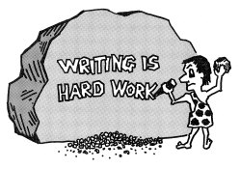
Introduction to scientific paper writing
Dr. Amuzie Chidinma Ihuoma Department of Community Medicine
Courtesy: Global Health Professional Multidisciplinary Practices Journal

Slide 2
Outline
Learning Objectives
Introduction
Justification
Research manuscripts
IMRaD Structure
Abstract/title
Journal search
Considerations for journal selection
Ethical issues in writing
Challenges
Recommendation
Conclusion
References

Slide 3
Learning Objectives
At the end of this presentation, we should be able;
To identify the types of manuscripts, abstracts and titles
To describe how to present each section of a manuscript
To conduct journal search using different platforms
To detect the ethical issues of concern while writing a scientific paper

Slide 4
Introduction
Field reports, factsheets, short communication, bulletins, newsletters, correspondence, letter to Editor, research manuscripts
Usually follows the IMRaD structure
Writing is thinking made visible: concepts, facts, ideas, conclusion and recommendation
Sequence: high-level outline
Guidelines (STROBE, PRISMA, CONSORT)
Notes:
Concepts clarified, facts established or denied, ideas evolved, conclusions modified and recommendations are updated.

Slide 5
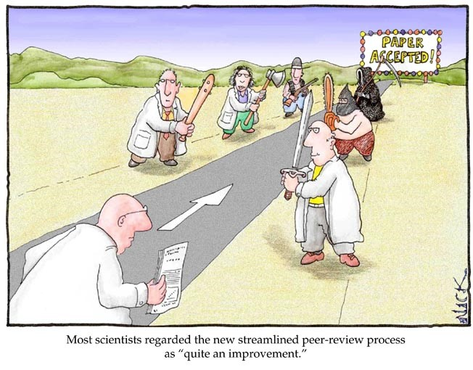
Justification
Record your work
Share your findings
Present new ideas, hypotheses, models
Help improve the health, safety, and well-being of the population
Improve your writing skills
Build your resume

Slide 6
Research Manuscripts
A manuscript is essentially the earliest draft of a project/dissertation or a research
It is the unpublished version of a project/dissertation submitted to agents and editors for publication consideration
Types of Manuscripts:
-Methods paper: describes a new or improved method
-Descriptive paper: describes a newly discovered object, such as a structure
-Hypothesis-testing paper: most common type

Slide 7
IMRaD Structure
Introduction (this was the problem)
Methods and Materials (this is what we did)
Results (this is what we found) and
Discussion (this is how we interpret it)
Notes:
Methods, Results, discussion/conclusion, introduction, abstract

Slide 8
IMRaD -Introduction
What is the public health problem/hypothesis/question and why should anyone care?
Convince audience that the study has information that is NEW and USEFUL
Funnel description: from known to unknown to question
Provide background information about topic (what is known)
Provide the rationale for the study: why study is needed in first place (what is unknown)
Present study objective
Use past tense, except when referring to established facts, KISS
The last sentence will spell out the aim/objective (SMART)/hypothesis of the work
DON’T over reference, go off tangent, answer your hypothesis
How long? how detailed? finding it hard (writer’s block)? Summary?

Slide 9
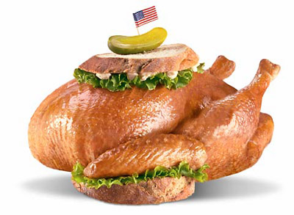
IMRaD –Methods 1/2
How did you seek to answer it?
The “Engine Room” or the “Heart” of Scientific paper
Permits repetition of the work
Do not present results (exception Pyschology literature sometimes presents recruitment and subject description in Methods (e.g., paragraph 1 of Results)
However, should be linked to results
Journal specific
Study design, study setting (study area + site), study sample, measurement of variables, statistical analysis, data quality, ethical consideration
Notes:
Study site=facility, services, context/system

Slide 10
IMRaD –Methods 2/2
Study Design
Study setting: Study Area (Geography) + Study Site (facility/services/system/context)
Study Subjects: Eligibility criteria, time frame (seasonality)
Sampling size determination
Sampling method and procedures
Research tools & methods
Measurements of variables
Intervention
Statistical Methods
Laboratory Methods
Ethical Considerations

Slide 11
IMRaD-Results
What did you find? Follow journal guideline
Include only variables that answers your research question
Well labelled tables and figures, footnotes, consistent decimal places, cite all tables in the manuscript text
Numbers should add up
Five paragraphs: study population, key variable/primary outcome, bivariate, multivariate, sub-analysis (if done)
Smoothen the wording so that it flows well and reduce the words

Slide 12
IMRaD-Discussion
The first sentence of Discussion: Opening statement then findings
“This paper describes the investigation of a mumps disease outbreak in …… using”
“We found…”, unexpected findings inclusive
Do not simply repeat results
Presented in logical order
Use words rather than numbers or statistics
All findings must be in the result section
AVOID promising future papers or studies, ‘more research needed’ (unless you’re specific), cliches, bragging (first ever)

Slide 13
Limitations/Conclusion
Limitations: They are uncontrollable factors that will affect the quality of a research
They are not the same as challenges
Provide a very brief summary of the Results and Discussion
Emphasize the implications of the findings, explaining how the work is significant and providing the key message(s) the author wishes to convey
Provide the most general claims that can be supported by the evidence
Provide a future perspective on the work
Notes:
Limitations
They limit the extensity to which a study can go, and sometimes affect the end result and conclusions that can be drawn.
They are uncontrollable factors that will affect the quality of a research . They are not the same as challenges. Challenges are difficulties. And if they don’t affect your results, you need not mention them.

Slide 14
Abstract
A summary of the contents of a book, article, presentation or speech
Conveys the most interesting and important part of your work
Acts as a stimulus to the readers to get interested in knowing more about the study or program
Usually structured (format depending on journal), short, range: 150 - 400 words
-250 words: PAMJ, GMJ, SH@W
Receives much wider distribution and potential to be read than a full article
Is presented in electronic databases e.g Medline, PUBMED, Science direct
Structured vs. unstructured abstract
Complete, concise, clear and coherent
No passive voice, use simple past tense, avoid nominalization
Avoid inverted word order
Notes:
A story telling with a plot. Nominalization means using nouns instead of verbs. We made a consideration of- we considered,

Slide 15
Title
First introduction readers and reviewers have to your work
Give it as much consideration as any other section
Include the problem being studied, and two of the following: Method, Result, or Conclusion
Types: Descriptive, interrogative and declarative, creative
Classification based on sentence construct: Nominal, compound and full-sentence title
Use simple word order, and full scientific names, avoid abbreviations
Avoid long titles (the recommended length is 10 - 23 words)
those which begin with redundant words such as “A study of…”

Slide 16
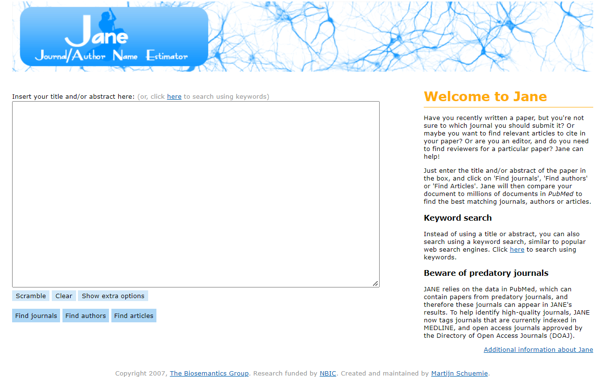
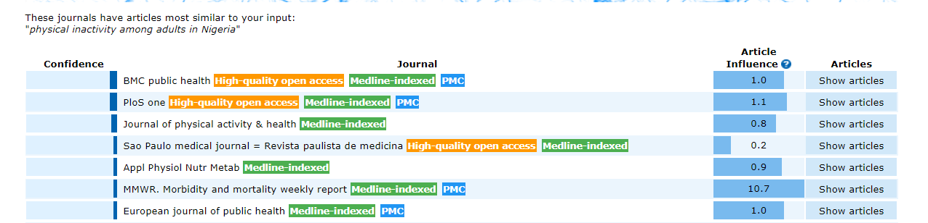
Journal Search-1/2
Journal Author Name Estimator (JANE)
Publisher journal finder; Elsevier, Springer, Web of science, Nature, SAGE, Willey, Taylor and Francis, JCR
Notes:
Confidence; how similar your input is to the articles in the journal listed. Article influence, measures how often articles in the journal are cited within the first five years after publication.

Slide 17
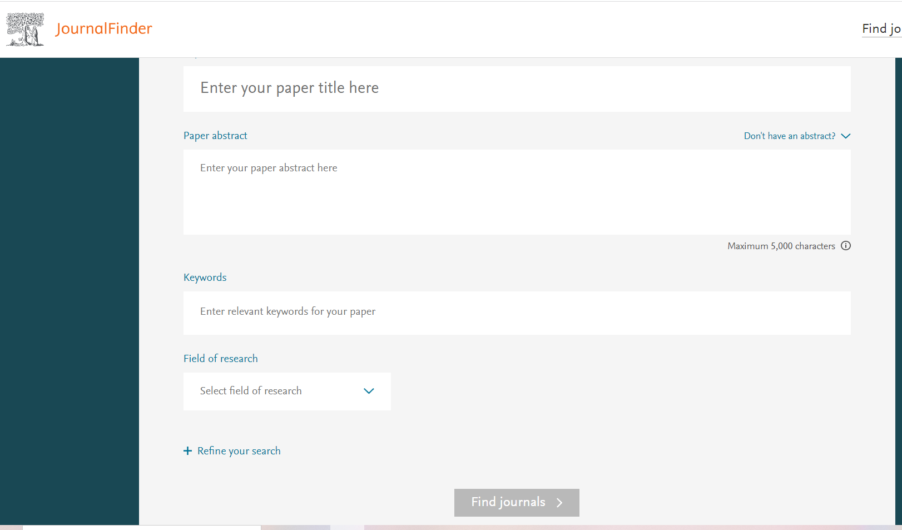
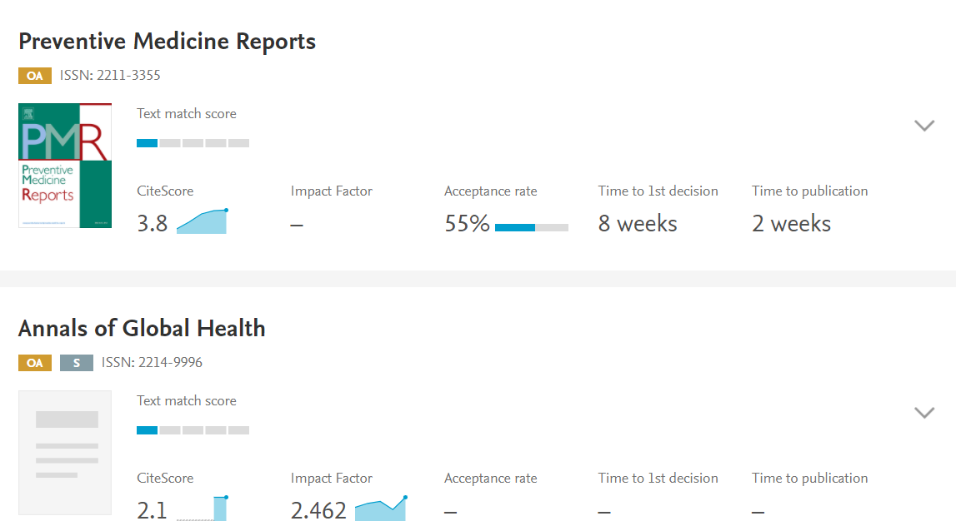
Journal Search-2/2
Elsevier Journal Finder

Slide 18
Consideration in journal selection
Journal Scope
Ranking; Science Citation Index - Thompson Reuters ranking (Impact factor), SCImago journal rank (SJR), Eigenfactor score
Index; PUBMED, Scopus, AJOL, Thompson Reuter’s Web of Science, Google Scholar
BEWARE of predatory journals: Beall’s list, journal evaluation tool
Access to published work; Subscription based, open access(gold, green, bronze, black) and hybrid
Article Processing Charge/publication charge
Frequency of Publication
Timeline/acceptance rates
Peer Review process; open, single- and double-blinded
https://beallslist.net/how-to-recognize-predatory-journals/

Slide 19
Ethical Issues in writing
Scientific misconduct (Plagiarism, fabrication and falsification)
Plagiarism: word-for-word /paraphrasing
Authorship: Gift (Honorary), Guest (Prestige), Ghost authorship
Salami slicing/Redundant publication
Negligent carelessness: Inadequate literature review, faulty statistical analyses
Citation Bias: Self-citation, selective citation, failure to read the primary sources
Copyright/licensing policies

Slide 20
Revision
Create your plan
Choose an appropriate journal
Choose a master manuscript
Ensure you meet the specified journal’s requirements
Standardized reporting guidelines
Order of writing different sections of the paper
Cover letter, title page
ORCID number, list of co-authors names, affiliations and emails
Proceed to the submission process: Online/email

Slide 21
Challenges
Lack of interest in research
Poor writer’s skills
Lack of time
Inadequacy of funds
Lack of research guiding
Lack of institution/library access: HINARI

Slide 22
Recommendation
Individual level
Develop interest
Attend manuscript workshops/seminars
Online courses
Get affiliated with a research team
Networking/Collaborate with your colleagues
Grant hunting
Time management
Departmental level
Reinforcing mentorship
Administrative level
Organization of manuscript seminars
Availability of institutional/library access to subscribed articles

Slide 23
Conclusion
If the paper does not elicit any enthusiasm in your study, it is unlikely that a journal will consider publication
The paper needs to be written concisely and has to stimulate the reader’s interest
Appropriate journal selection should be prioritized
Always review the final version of the manuscript before you log into the submission process
Notes:
We write for readers and not for ourselves

Slide 24
Bibliography
The Visual Communication Guy. How to Organize a Paper: The IMRaD Format [Internet]. [accessed 2022 Mar 5]. Available from: https://thevisualcommunicationguy.com/writing/how-to-organize-a-paper/how-to-organize-a-paper-the-imrad-format/
Springer. Overview of IMRaD structure [Internet]. Springer. 2020 [accessed 2022 Mar 5]. p. 1. Available from: https://www.springer.com/gp/authors-editors/journal-author/overview-of-imrad-structure/1408
Alfakih DAH. A Training Program to Enhance Postgraduate Students’ Research Skills in Preparing a Research Proposal in the Field of Curriculum and Instruction Methods of Arabic Language. IOSR J Res Method Educ. 2017;07(03):01–6.
Springer_Nature. Green or Gold routes to open access [Internet]. Springer. 2021 [accessed 2022 Mar 3]. Available from: https://www.springernature.com/gp/open-research/about/green-or-gold-routes-to-oa
Bavdekar SB. Authorship issues. Lung India. 2012;29(1):76–80.
Ali F, Qasem A, Zayid IM, Journal E. The Challenges and Problems faced by Students in the early stage of writing Research Projects In L2, University Of Bisha, Saudi Arabia. Eur J Spec Educ Res. 2019;0(0):33.
Tullu M. Writing the title and abstract for a research paper: Being concise, precise, and meticulous is the key. Vol. 13, Saudi Journal of Anaesthesia. 2019.

Slide 25


