Slide 1
WRITING A GOOD RESEARCH INTRODUCTION
Dr Akaninyene Mark
MBBcH(Cal), MPH(Uniport), FWACP, PhD in view
Consultant Public Health Physician
akanmark466@gmail.com

Slide 2
Outline
Background –Scope of the problem and gap in knowledge
Statement of Problem
Study Justification –How study fills the gap
Research Questions
Hypotheses
Statement of Objectives
General Objective/aim
Specific Objectives
Significance of the Study (Benefits derivable from study)
Conclusion
References

Slide 3
Introduction
The introduction is the reader’s ‘’gate’’ into the research work.
It should therefore present a concise summation, provide direction, focus and purpose of the work in such a way as to leave a positive impression on readers.
It should contain clear aspects of the research questions and the background theoretical framework.
It should go further to expound its potential contribution to knowledge even as it highlights the significance of the study by providing background information that put the research in its perspective.

Slide 4
It offers a context for the reader’s attention, reader’s mental picture on the topic and identifies gaps in existing knowledge that need to be addressed
It provides a rationale for the study, defines the focus while pointing out its values.
A good introduction is a must read part of the research by assessors and should be brief, captivating, interesting with good citation.
In term of length, there is no rule about how long an introduction should be, it should be concise and about 10 ℅ of the total dissertation length. (WACS,2022-writing a full length research paper ).

Slide 5
Questions to be answered in introduction includes
The purpose and importance of the study
The scope of the study
What is already known on the topic
The limitations from previous studies
Adequacy of literature reviewed
Aim/ main objectives of the study
The potential addition to existing body of knowledge
The introduction could also follow the ‘T I O C’(Trend, Issues, objective, Contribution) approach.

Slide 6


Slide 7
Background
The background sub-section of the introduction provides a brief introduction of the research problem
Features are
Precise definition of the research problem and key concepts
The causes of the problems
What is known about the topic
Historical antecedents
Need to show that you are familiar with the literature, local and global.
If you have a related study, cite it. If not, cite a related study in your environment and link your study to it to demonstrate the furtherance of knowledge

Slide 8
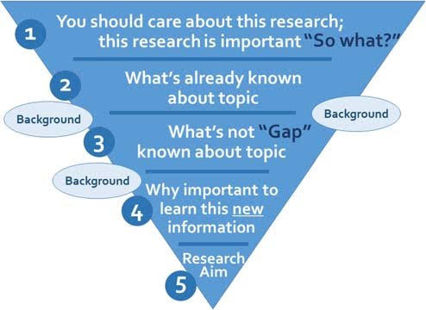

Slide 9
Problem statement
Statement of the problem subsection of the introduction provides important descriptive statistics of the problem
The size of the problem
The severity of the problem: effect on morbidity and mortality and the age mostly affected
The consequences to those affected
The consequences to the health system
The consequences to the economy
The socio-economic issues of the topic
The cost and the feasibility of intervention x-rayed.

Slide 10
The nature, scope and trend/pattern of the problem
A local perspective observed or documented eg in NDHS
A global perspective to show how the local picture fits into global data e.g MMR in Nigeria
Statement of problem should not be a long narrative
A clear and precise problem statement must be articulated to provide a context for the study and presented to the readers
The perceived problem should naturally lead to a research question and should be clearly defined and understood

Slide 11
A good problem statement must take the audience into consideration and must be made readable and comprehensible by the readers
It presents a solid compelling and pragmatic research agenda that addresses a pressing need of the population
It comprises three key elements
An obvious problem and with the context/background that makes it worth addressing
Practical means of providing solution to the problem
The importance and goal of solving the problem

Slide 12
Steps adopted for a good problem statement
i. Analyse and understand the chosen topic.
ii. Have a clear vision of the intended goal of the research
iii. Define the problem and specify why solving it is important
iv. Define the background/context upon which the topic is premised
v. Analyse the problem and explain the impact
vi. Build a rationale for the proposed study
vii. Identify the gap and explain the causes of the gap
viii. Conceptualize the solution to the problem
ix. Review and ensure that the 5W’s what, who, when, why, where are taken care of
x. Summarize all the points and clearly/ concisely write down the problem statement

Slide 13
A good example of problem statement
Many women in ado LGA of Benue state died from excessive bleeding after childbirth. These occur despite the use of oxytocin to prevent such bleeding in the hospital and or health centers. Inadequate training and attitude of health workers have been deemed to be the significant factors responsible for this(NDHS,2022). Ideally no woman should die of childbirth. The recurrent training and retraining of healthcare workers in a maternity units may help reduce this challenge which is necessary to reduce the alarming rate of maternal deaths in ado LGA.
In the above statement, the problem is clearly stated, the ideal solution is known, and the solution and its necessity are provided.

Slide 14
Justification
It refers to the rationale that makes the study acceptable and worthwhile to be embarked upon.
It is a formal information conveying the reasoning behind your study, the scientific basis behind the study design and methodology
It depicts the researcher’s conviction and motivation that the study will yield a significant result within a specified budget.
Justification needs to be legitimized by citing applicable references, policies, any existing theories that can be extrapolated to this study
Describe why the subject deserves attention, what difference the study will make in the practice of the discipline, in the management of patients, in the patients’ adherence to therapy etc., what gap in knowledge it will fill.

Slide 15
A thorough review of literature is invaluable in writing the justification as it exposes existing gaps in area of the study
A common mistake is that for some researchers to justifies the study with a phrase ‘Little Is Known About (LIKA syndrome) the study in this population
This argument often does not hold, unless one is able to demonstrate significant differences between the population of interest and the population where the studies has been completed. Such difference may influence the outcome of the research.

Slide 16
Consider the following questions before coming-up with justification
What is the existing problem?
Why is this research necessary?
How does this research relate to the existing problem?
What is the real aim of this research?
What benefits to the larger population are desirable from this research?
What are the implications of not solving this problem?
How does one present all the above in an appealing manner to the reader?

Slide 17
Research questions
Research Questions sub-section of the introduction converts the Specific Objectives into questions that must be answered
A research question is 'a question that a research project sets out to answer and all the processes and analysis are intended to proffer an answer to that question.
Research questions are mostly used in qualitative studies, where there is no precise measurement of the parameters of the study
For example: Does the Epidemiological transition theory explain the increasing prevalence of hypertension in Nigeria?
What questions will be laid to rest by this study and it should be answered.

Slide 18
Research questions can also be used in quantitative studies, but the questions are framed to reflect the type of data collected in the study since it consists of numbers and statistics
-For example: Does measles vaccination at 9 months of age confer immunity against measles infection?
Research questions may be descriptive, relational, comparative or causal in nature
Research question should be crisp, simple, concise, specific, direct, focused, and easily comprehensible
It guides the thoughts, reading and subsequent exploration and guards against straying away from the central topic.

Slide 19
Attributes of a good research question
A good research question should be useful, focused, interesting, arouse curiosity and engage the attention of the reader, in addition of the following attributes
Clarity
Specific
Concise
Feasible
Answerable
Steps to develop a good research question
i. Choose an interesting, curious/passionate topic ii. Perform preliminary search on the topic and consider your audience iii. Write down the questions and evaluate them iv. Write down your final research questions

Slide 20
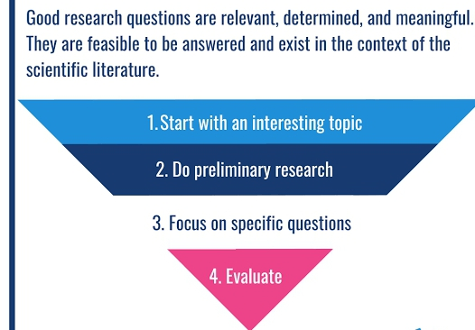

Slide 21
Examples of Research Questions
Work and Pregnancy outcome study
Does work outside the home affect the health of newborns ?
What factors in paid work or domestic work affect pregnancy outcome?
What other modifiable factors are associated with LBW and preterm births?
Sexual abuse among school adolescents study
Is there a difference between the prevalence of sexual abuse among urban school adolescents and their rural counterparts?
Is there a difference between the pattern (types, frequency, consequences) of adolescent sexual abuse?
Are the characteristics of the perpetrators of adolescent sexual abuse in urban setting similar with or different from those in rural settings?
What are the factors associated with sexual abuse among adolescents

Slide 22
Research Hypotheses
A hypothesis is a supposition that is tested by collecting data leading to rejection or acceptance, a formal statement of a scientific ‘uncertainty’ requiring research and statistical evaluation to address.
What outcomes or end points do you expect from scientific deductions and existing knowledge
A hypothesis is an assumption which is the expression of a tentative solution to a research question, phrased in the form of a conceptual relationship between the dependent and the independent variables – substantive hypothesis
A hypothesis is tentative because it must be tested empirically by the research and cannot be verified until then. It is usually based on theoretical paradigms

Slide 23
A research hypothesis is the prediction of the relationship between one or more factors and the research question
Its predicts the likely results of the study, and is often called an ‘educated guess’, because it is influenced by the already published data
It conveys scientific validity to the research methodology.
Although most studies are conducted in anticipation of a positive result, research hypotheses are often framed in the negative, hence called a Null Hypothesis .
-The opposite is the alternate hypothesis

Slide 24
To be complete, a hypothesis must include three components: The variables, population and the relationship between the variables
A hypothesis is the tool of quantitative studies (only!). It can be generated from cross-sectional studies, tested with analytical studies and can only be validly confirmed using well designed experimental quantitative research designs.
Types of Hypotheses
Null hypothesis- no difference
Null-There is no difference in MMR between grand-multigravida and primi-gravida

Slide 25
ii. Alternate hypothesis- there is a difference in MMR between grand-multigravida and primi-gravida
iii. Simple hypothesis- it predicts a simple relationship between two variables. Eg., MMR is higher in rural than urban areas
iv. Complex hypothesis-involve multiple dependent and independent variables eg., smoking and alcohol intake increase the rate of sleep apnoea and insomnia
v. Composite hypothesis- exact value is not predicted for the dependent variable eg., fruits and colon cancer
vi. Directional hypothesis- it predicts the direction of relationship b/w dependent and independent variables
vii. Non- directional hypothesis

Slide 26
viii. Logical hypothesis- based on logic and cannot be tested scientifically, used among philosophers
ix. Working hypothesis- opposite of logical. Assumption that can be tested with empirical data. Eg., using the labour care guide in maternity units reduces MM in a rural population
x. Causal hypothesis- cause and effect relationships eg., cigarette smoking is linked to lung cancer and may cause other cancer in Nigerian population.
xi. Associative hypothesis- unlike causal.eg., intake of carbonated drinks is associated with obesity in population
NB- The most popular are the Null and Alternate hypotheses

Slide 27
Null and Alternative Hypotheses
H₀ assumes that there is no association between the predictor and outcome variables in the study population.
It is the basis for any statistical significance test
Thus, one never accepts H₀, but rather one rejects it with a certain level of significance.
In contrast, H₁ makes a claim that there is an association between the predictor and outcome variables.
One does not directly test H₁, which is by default accepted when H₀ is rejected on the basis of the statistical significance test results.

Slide 28
One- and Two-sided hypotheses Tests
The investigator must also decide whether a one- or two-sided test is most suitable for the clinical question .
A one-sided H₁ test establishes the direction of the association between the predictor and the outcome
For Eg., the prevalence of ovarian cancer is higher in nulliparous women than in parous women.
However, a two-sided H₁ test establishes only that an association exists without specifying the direction
—For Eg., the prevalence of ovarian cancer in nulliparous women is different (ie, either higher or lower) from that in parous women.
In general, most hypothesis tests involve two-sided analyses.

Slide 29
Hypothesis testing:
Involves application of statistical test of significance to determine the likelihood of finding the relationship observed in the sample; if in fact no such relationship exists in the population from which it was drawn.
The assumption of no relationship is referred to as the null hypothesis
The rival assumption that a relationship exists within the population is the alternative hypothesis
A good hypotheses should not be a random assumption or statement. It must be specific, limited in scope, testable and can be proven to be false

Slide 30
Steps in Hypothesis testing
State the research questions
Search more literature, define the variables
Formulate the null (H₀) and alternative (H₁) hypotheses
Compute the test statistic for the given conditions
Calculate the resulting P value
Either reject or do not reject H₀ (reject H₀ if the P value is less than or equal to a pre-specified significance level [typically .05]; do not reject H₀ if the P value is greater than this significance level),
Interpret the results according to the clinical hypothesis relevant to H₀ and H₁

Slide 31
Research Objectives
The study objective is an active statement about how the study is going to answer the research questions.
In planning a research, it is of utmost importance to describe the aim (purpose)
General objective or aim of the study is usually broad, and often close to the topic of the study, with the addition of action words like ‘To determine… ‘To compare… ‘To assess….
Example: 1.The prevalence of hypertension and its modifiable risk factors amongst lecturers in a medical school in south-south Nigeria
General objective: To assess the prevalence of hypertension and its modifiable risk factors amongst lecturers in medical school in south-south Nigeria

Slide 32
The study aims specify what the research will answer, but the study objectives specify how the answers will be achieved.
The study objectives divide the aim into several smaller segments, each representing an important section of the research work.
It takes the form of a numbered list and each of the objective should stand alone.
The aim and objectives determine the scope, depth and direction that the study will take.
It is recommended that only one aim and at least four objectives be formulated for a dissertation.

Slide 33
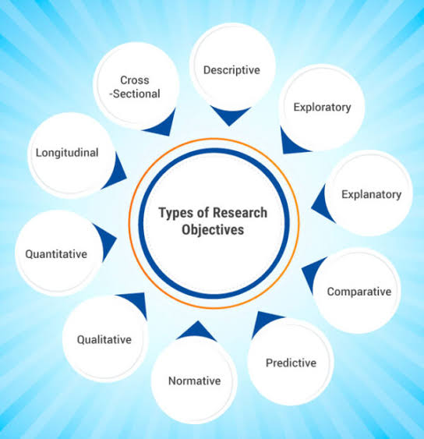

Slide 34
Specific objectives of the study is said to be SMARTER
S specific (focused, well defined)
M measurable (quantifiable)
A achievable (feasible)
R realistic ( considering resources)
T time bound ( within time limits, deadlines)
E ethical (devoid of flaws, without ethical violation )
R research ( add to the body of knowledge )

Slide 35
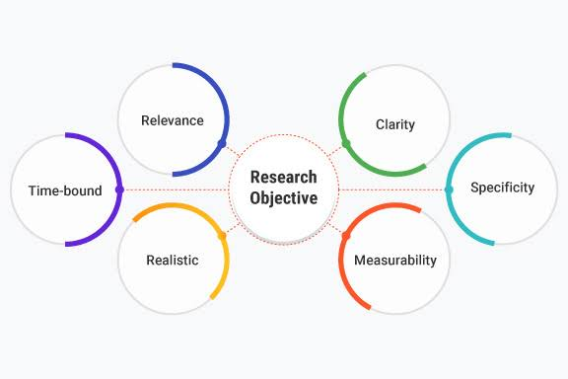

Slide 36
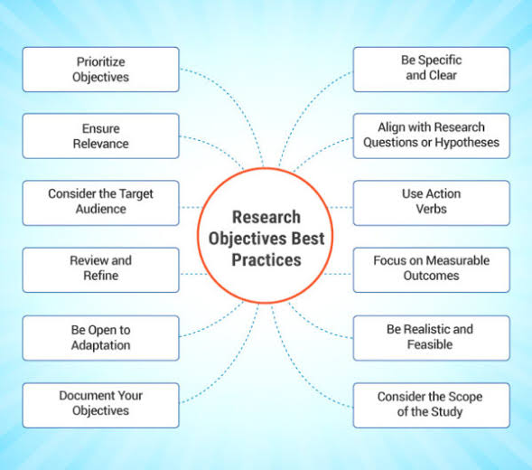

Slide 37
Examples of study objectives
General:
To compare the health status of working and non- working school children
Specific:
1.To compare socio-demographic characteristics of working and non working school children
2. To describe types of work, work pattern and reasons for working among working children
3. To compare the prevalence of common health problems in working and non working children

Slide 38
General:
To determine the effect of fruit consumption on blood sugar levels among diabetic patients
Specific:
1. To describe the dietary habits and especially fruit consumption habits of diabetic patients
2. To determine the prevalence of uncontrolled diabetes among diabetic patients
3. To measure the rise in blood sugar after consumption of various fruit meals in normal controls, patients with uncontrolled diabetes and those with controlled diabetes

Slide 39
General:
To determine the effect of health education intervention on reproductive health behaviour and occurrence of abortions among hairdressers
Specific:
1. To determine the prevalence of risky sexual practices, contraceptive use and abortions among hairdressers
2. To determine the factors associated with risky sexual practices, contraceptive use and abortions
3. To design and implement a health education programme to reduce the prevalence of risky sexual behaviour and abortions

Slide 40
Tips for developing research questions, hypotheses and objectives for research studies
Perform a systematic and thorough literature review to increase knowledge and familiarity with the chosen topic and to assist with research development.
Learn about current trends and technological advances on the topic.
Seek careful input from experts, mentors, colleagues to refine your research question as this will aid in developing the research question and guide the research study.
Use the FINER criteria to develop research question. FINER = feasible, interesting, novel, ethical, relevant- (To scientific knowledge, To clinical and health policy, To future research)

Slide 41
Ensure that the research question follows PICOT format. PICOT = population (patients), intervention (for intervention studies only), comparison group, outcome of interest, time.
Develop a research hypothesis from the research question.
Develop clear and well-defined primary and secondary (if needed) objectives.
Ensure that the research question and specific objectives of the study are answerable, feasible and clinically relevant, in addition to SMARTER approach

Slide 42
Significance of study
The significance of the study is often subsumed under the Justification of the Study, and considered to be the same.
They are similar, but not exactly the same. While the justification of the study indicates gaps in the literature that will be filled by the proposed study
The significance of the study highlights the contributions of the study to knowledge and public health , Contribution to your field of practice, how results will influence provision of health services

Slide 43
Example 1.“It is hoped that the findings of the study would provide the information on the situation in the Niger delta region of Nigeria, for necessary corrective actions.”
2.“The formative research for social marketing programmes seeks a better understanding of the clients, especially the knowledge, attitude and use of the product or service in the recipient communities. This study hoped to provide these essential information, to help kick start a social marketing programme that would drive up the uptake of clinical preventive services in Nigeria.

Slide 44
CONCLUSION
A good introduction in research provides fundamental information to enable the reader to appreciate a specific problem and how the research will address the problem.
It is usually written in a compelling manner to engage and sustain the interest and attention of the reader/ assessors to go through the entire work.
It is highly important that the introduction be clear, focused, succinct, engaging, interesting, devoid of ambiquity, backed up with scientific reasons/ justification, objectives, research questions and hypotheses testing if well spell-out in your faculty hand book.

Slide 45

Thank U
for
Listening

Slide 46
References
Cohen DJ, Crabtree BF. (2008). Evaluative criteria for research in health care: Controversies and Recommendations. Annals of Family Medicine 6:331-339. doi:10.1370/afm.818
WACP Research revision courses, 2019, 2020, 2021, 2022, 2023
The research Brief 2022, An invaluable resource for postgraduate candidates and supervisors
Qualitative Research Methods: A Data Collector’s Field Guide. Module 1: Qualitative Research Methods Overview/ Introduction
Hammarberg K., Kirkman M., de Lacey S. (2016). Introduction to Qualitative research methods: when to use them and how to judge them, Human Reproduction 31(3): 498–501. https://doi.org/10.1093/humrep/dev334

